Slide 1
Applied Machine Learning
Lecture 1

Slide 2
Outline
Introduction to Course
Prerequisites
Text and Reference Books
Grading Policy
What is Machine Learning?
Why use Machine Learning?
Types of Machine Learning

Slide 3
Pre-requisites
Coding behavior
Ability to understand the code
Data structures and complexity analysis
Probability theory
Derivatives, Integration, and matrix manipulation
Brief knowledge of edge devices

Slide 4
Recommended Books
Hands-On Machine Learning with Scikit-Learn, Keras, and TensorFlow by Aurélien Géron
Understanding Machine Learning - From Theory to Algorithms by Shai Shalev-Shwartz and Shai Ben-David
Applied Machine Learning by David Forsyth
Machine Learning by Tom M. Mitchell

Slide 5
Course Objective
The objective of this course is to develop students’ understanding and interest in Machine Learning by introducing fundamental ML methods, algorithms, and their mathematical foundations. The course provides hands-on experience in implementing and evaluating ML models using real-world data, while developing students’ ability to critically analyze ML techniques, and designing practical ML solutions for real-world applications, including deployment on edge devices.

Slide 6
Course Learning Outcomes
No. | Course Learning Outcome (CLO) Statements | Taxonomy Level | PLO
1 | Apply fundamental Machine Learning concepts and mathematical formulations to formulate and solve learning problems. | C3 | 1
2 | Apply appropriate Machine Learning algorithms to solve classification, regression, clustering, and pattern-recognition problems. | C3 | 1
3 | Apply model evaluation, feature engineering, and dimensionality reduction techniques to assess and improve ML models using real-world datasets. | C3 | 1
4 | Design solutions using machine learning models with supervised or unsupervised techniques to address engineering challenges. | C6 | 3

Slide 7
Weekly Course Breakdown
Refer the course outline document

Slide 8
Assessment Tools and Grading Criteria
Assignments (3-5) 10%
Quizzes (4 – 8) 10%
CEP (1) 10%
Mid Term I 15%
Mid Term II 15%
Final Exam 40%

Slide 9
Grading Scheme
Absolute Grading scheme will be applied. Grades will be assigned according to the following table.
Percentage Marks | Grade | GPA | Percentage Marks | Grade | GPA
More than 90 | A+ | 4.00 | 66 – 70 | C+ | 2.33
86 – 90 | A | 4.00 | 62 – 66 | C | 2.00
82 – 86 | A- | 3.67 | 58 – 62 | C- | 1.67
78 – 82 | B+ | 3.33 | 54 – 58 | D+ | 1.33
74 – 78 | B | 3.00 | 50 – 54 | D | 1.00
70 – 74 | B- | 2.67 | Less than 50 | F | 0

Slide 10
Now Let’s Start the Course
☺

Slide 11
Why is this course important for Engineers?
To complete the degree ☺
Applied Machine Learning allows electrical engineers to move from model-based and rule-based systems toward intelligent, adaptive, and data-driven engineering solutions.
  Data-Driven Engineering and Optimization
  Automation and Intelligent Control
  Fault Detection and Predictive Maintenance
  Smart Grid and Energy Management
  Renewable Energy Integration

Slide 12
What is Machine Learning?
Machine Learning is the science (and art) of programming computers so they can learn from data.
Slightly more general definition:
  Machine Learning is the field of study that gives computers the ability to learn without being explicitly programmed. (Arthur Samuel, 1959)
Engineering-oriented one definition:
  A computer program is said to learn from experience E with respect to some task T and some performance measure P, if its performance on T, as measured by P, improves with experience E. (Tom Mitchell, 1997)

Slide 13
Examples of Machine Learning
Spam Filter in the email
Weather prediction
House price prediction
Predicting whether a student will pass
Traffic prediction
Are these ML examples?
  Google Maps shortest route
  Downloading Wikipedia on the computer and answering queries
  Any system automation based on rules

Slide 14
How to Identify ML?
Ask three questions:
  Does the system learn from data?
  Does it improve or adapt based on previously observed data?
  Can it make predictions/decisions for new data based on what it learned?
If the answer is no, it is probably automation, mathematical modeling, optimization, or conventional control—not machine learning.

Slide 15
Why Use Machine Learning?
Machine Learning is great for:
  Problems for which existing solutions require a lot of hand-tuning or long lists of rules: one Machine Learning algorithm can often simplify code and perform better.
  Complex problems for which there is no good solution at all using a traditional approach: the best Machine Learning techniques can find a solution.
  Fluctuating environments: a Machine Learning system can adapt to new data.
  Getting insights about complex problems and large amounts of data.

Slide 16
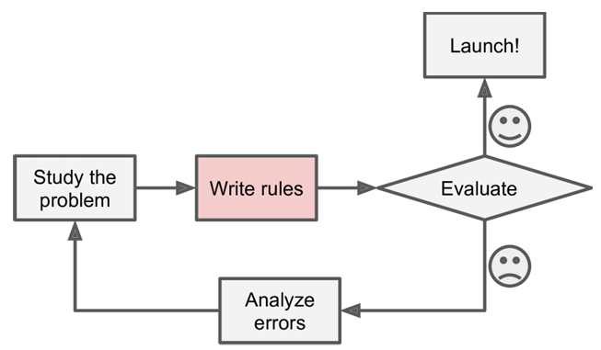
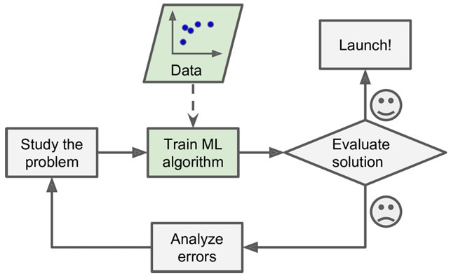
Spam Detection Problem (1/2)
Traditional Approach
Study the problem
Write rules
Check and analyze errors
Machine Learning Approach
Study the problem
Collect relevant data
Train and evaluate the model

Slide 17
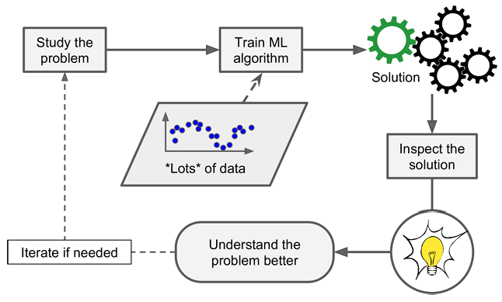
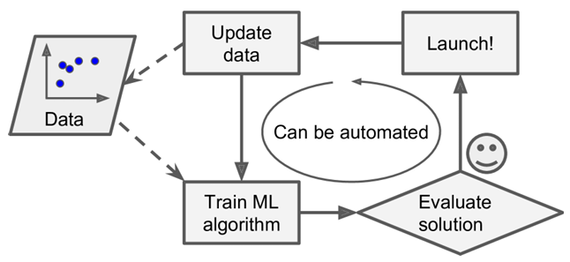
Spam Detection Problem (2/2)
ML may automatically adapt to change
Machine Learning can help humans learn
Applying ML techniques to dig into large amounts of data can help discover patterns that were not immediately apparent. This is called data mining.

Slide 18
Types of Machine Learning
Whether or not they are trained with human supervision
  Supervised
  Unsupervised
  Semi-supervised
  Reinforcement Learning
Whether or not they can learn incrementally on the fly
  Online Learning
  Batch Learning
Whether they work by comparing new data points to known data points, or by detecting patterns in the training data and building a predictive model
  Instance-based
  Model-based learning
These categories are not mutually exclusive. For example, a system can be supervised + online + model-based.

Slide 19
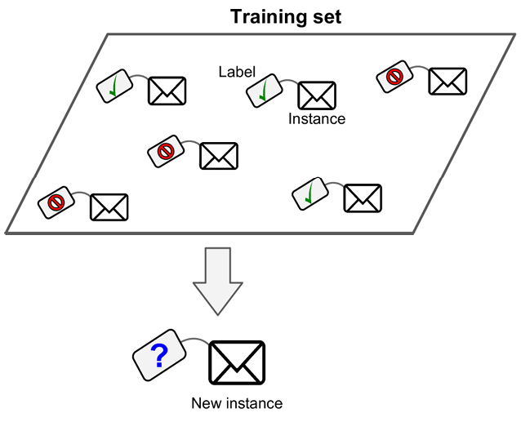
Supervised ML
In supervised learning, the training data you feed to the algorithm includes the desired solutions, called labels.
Here are some of the most important supervised learning algorithms
  k-Nearest Neighbors
  Linear Regression
  Logistic Regression
  Support Vector Machines (SVMs)
  Decision Trees and Random Forests
  Neural networks

Slide 20
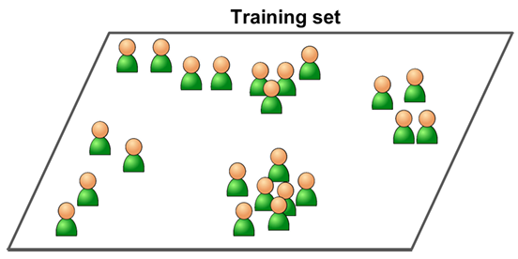
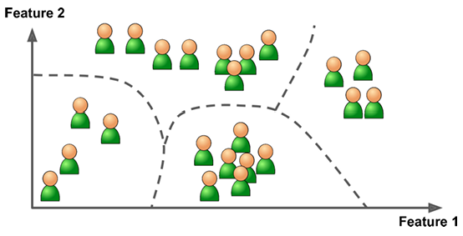
Unsupervised ML
In unsupervised learning, the training data is unlabeled. The system tries to learn without a teacher.
Here are some of the most important unsupervised learning algorithms
  K-Means
  DBSCAN
  Hierarchical Cluster Analysis (HCA)
  One-class SVM
  Isolation Forest
  Principal Component Analysis (PCA)
  Kernel PCA
  Locally-Linear Embedding (LLE)

Slide 21
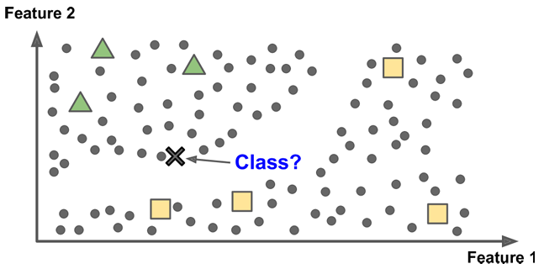
Semi-Supervised ML
Some algorithms can deal with partially labeled training data, usually a lot of unlabeled data and a little bit of labeled data. This is called semisupervised learning.

Slide 22
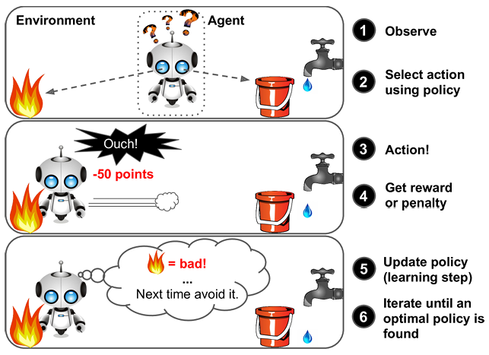
Reinforcement Learning
Reinforcement Learning is a very different beast.
The learning system, called an agent in this context, can observe the environment, select and perform actions, and get rewards in return (or penalties in the form of negative rewards).
It must then learn by itself what the best strategy, called a policy, is to get the most reward over time.
A policy defines what action the agent should choose when it is in a given situation.

Slide 23
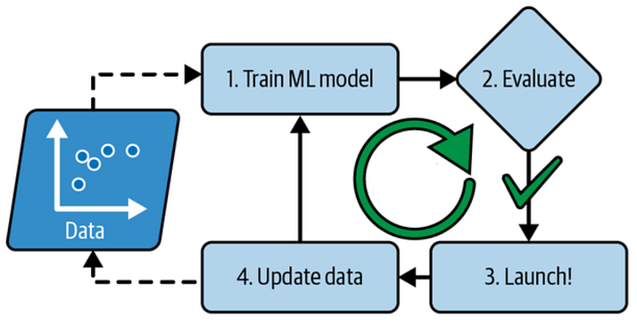
Batch Learning
In batch learning, the system is incapable of learning incrementally: it must be trained using all the available data.
This will generally take a lot of time and computing resources, so it is typically done offline.
First, the system is trained, and then it is launched into production and runs without learning anymore; it just applies what it has learned.
This is called offline learning.

Slide 24
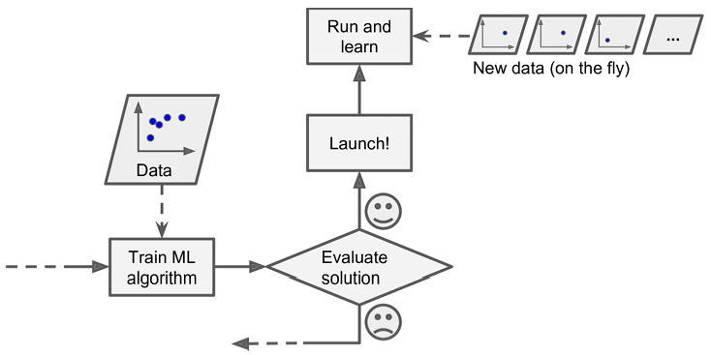
Online Learning
In online learning, you train the system incrementally by feeding it data instances sequentially, either individually or in small groups called mini-batches.
Each learning step is fast and cheap, so the system can learn about new data on the fly as it arrives

Slide 25
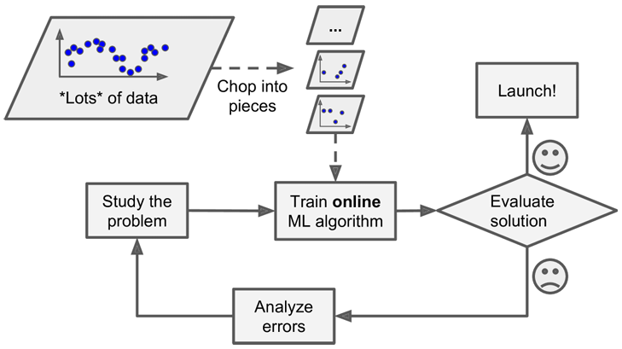
Advantage of Online Learning (out-of-core learning)
Online learning algorithms can also be used to train systems on huge datasets that cannot fit in one machine’s main memory (this is called out-of-core learning).
The algorithm loads part of the data, runs a training step on that data, and repeats the process until it has run on all of the data

Slide 26
Instance-Based Learning
Remember the examples and compare new data with them.
The model does not necessarily learn a complex mathematical model.
Instead, it stores training examples.
When a new example arrives:
Find similar examples → Use their information → Make prediction
Suppose we have historical motor measurements:
A new motor produces:
  Current = 14.5 A
  Vibration = High
  Temperature = 72°C
Prediction will be Bearing Fault
Current | Vibration | Temperature | Fault
10 A | Low | 40°C | Normal
15 A | High | 75°C | Bearing Fault
14 A | High | 70°C | Bearing Fault

Slide 27
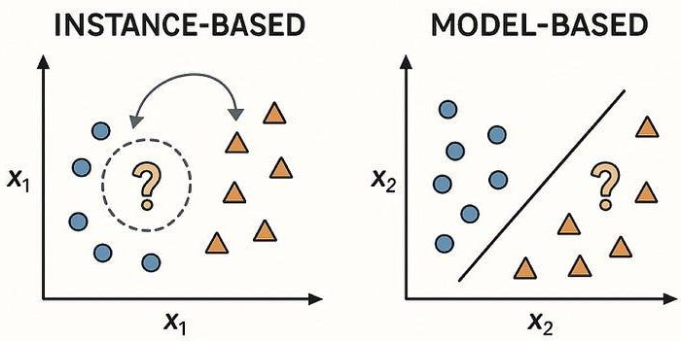
Model-Based Learning
Another way to generalize from a set of examples is to build a mathematical model of these examples, then use that model to make predictions.
This is called model-based learning.

Slide 28
Applied Machine Learning
Lecture 2

Slide 29
Outline
Supervised Learning:
Formulation
Setup
Train-test split
Generalization

Slide 30
Supervised ML
In supervised learning, the training data you feed to the algorithm includes the desired solutions, called labels.
Here are some of the most important supervised learning algorithms
  k-Nearest Neighbors
  Linear Regression
  Logistic Regression
  Support Vector Machines (SVMs)
  Decision Trees and Random Forests
  Neural networks

Slide 31
Examples of Supervised Learning
Classification
Predict a category/class.
  Fault / No Fault
  Theft / Normal electricity consumption
  Healthy / Faulty motor
  Spam / Not Spam
Classification → discrete output
Regression
Predict a continuous numerical value.
  Electricity demand
  Solar power generation
  Battery remaining useful life
  Motor temperature
  Wind speed
Regression → continuous output

Slide 32
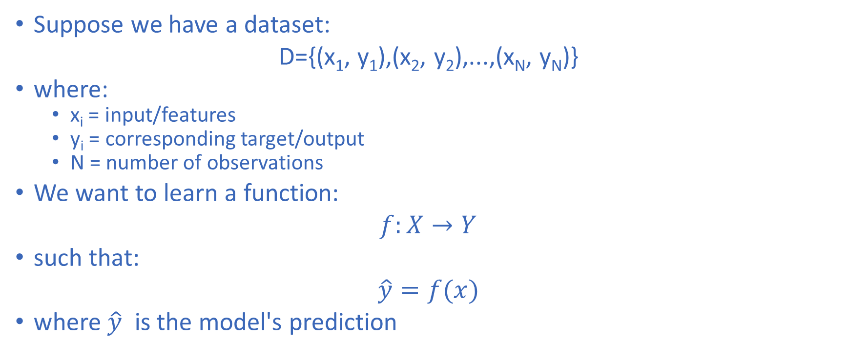
Mathematical Formulation of Supervised ML

Slide 33
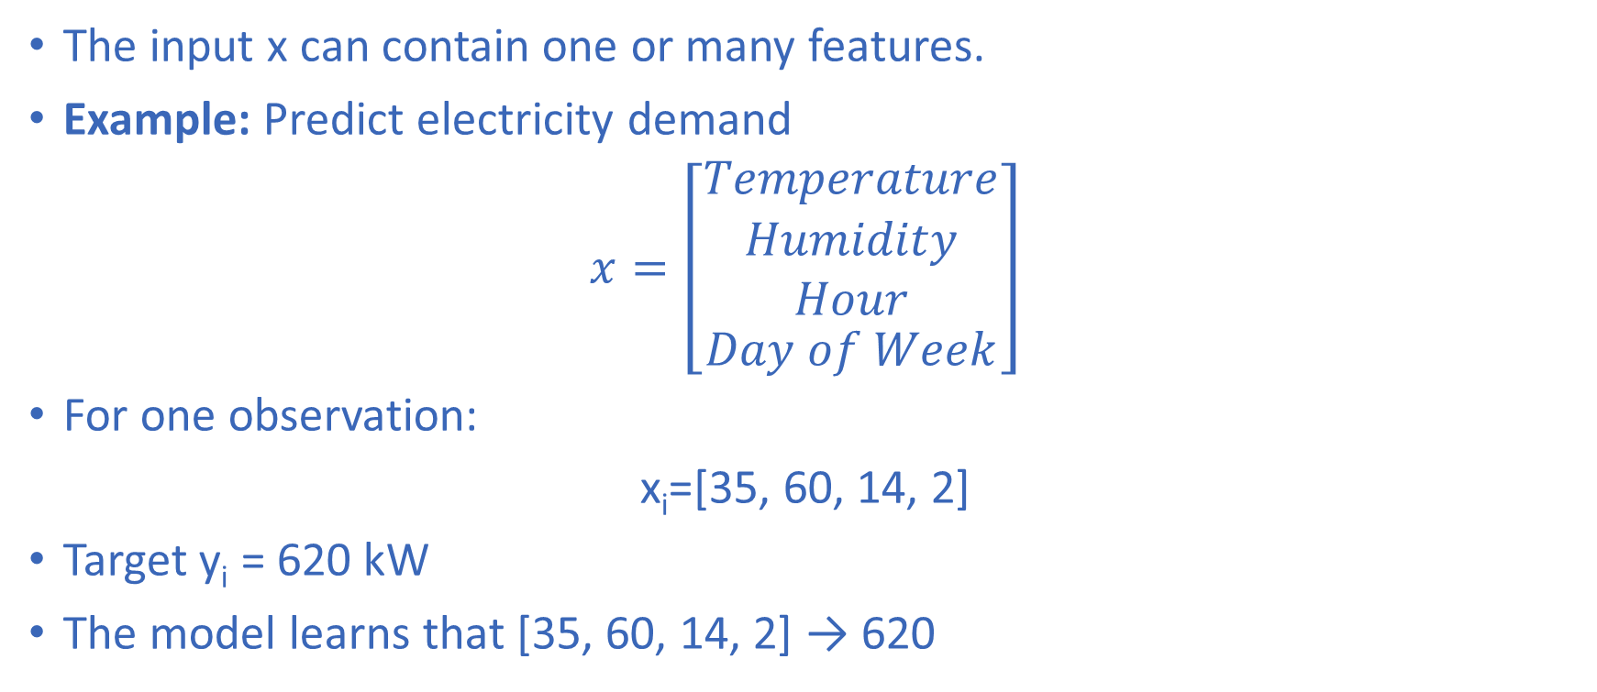
Mathematical Formulation of Supervised ML

Slide 34
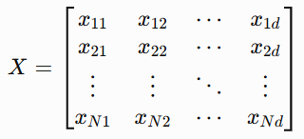
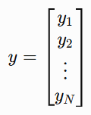
Mathematical Formulation of Supervised ML
Dataset as a Matrix
For N observations and d features
In simple terms
  Rows → observations
  Columns → features
  y → target

Slide 35
The Supervised Learning Pipeline
Real-world problem
Data Collection
Input Features (X)
Target y
Train-Test Split
Model Deployment
Model Evaluation
Model Training

Slide 36
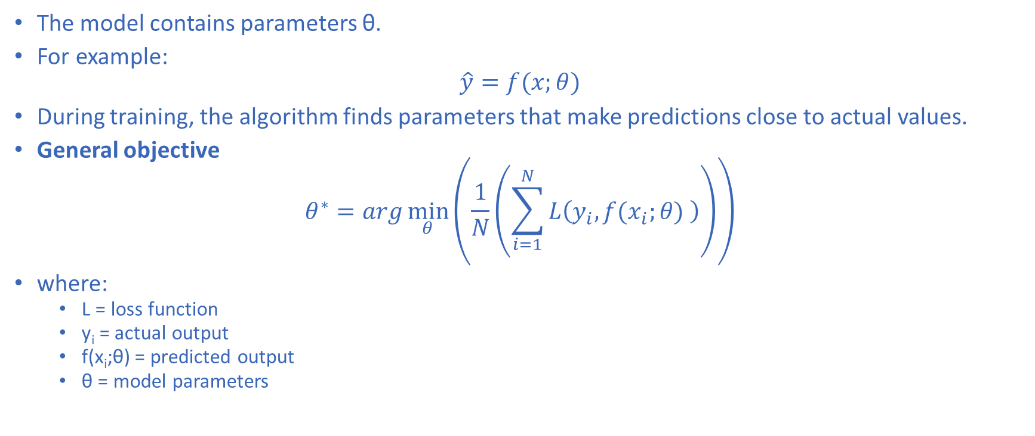
Training the Model

Slide 37
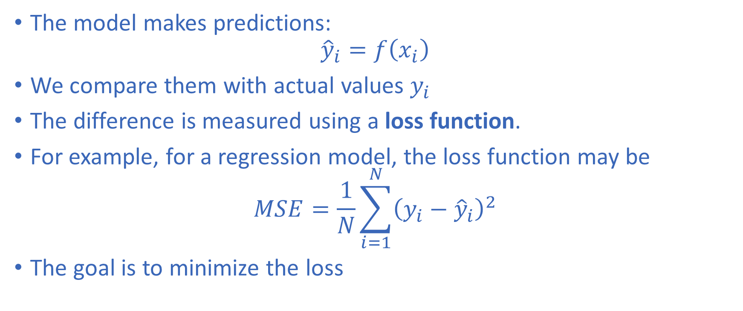
Loss Function

Slide 38
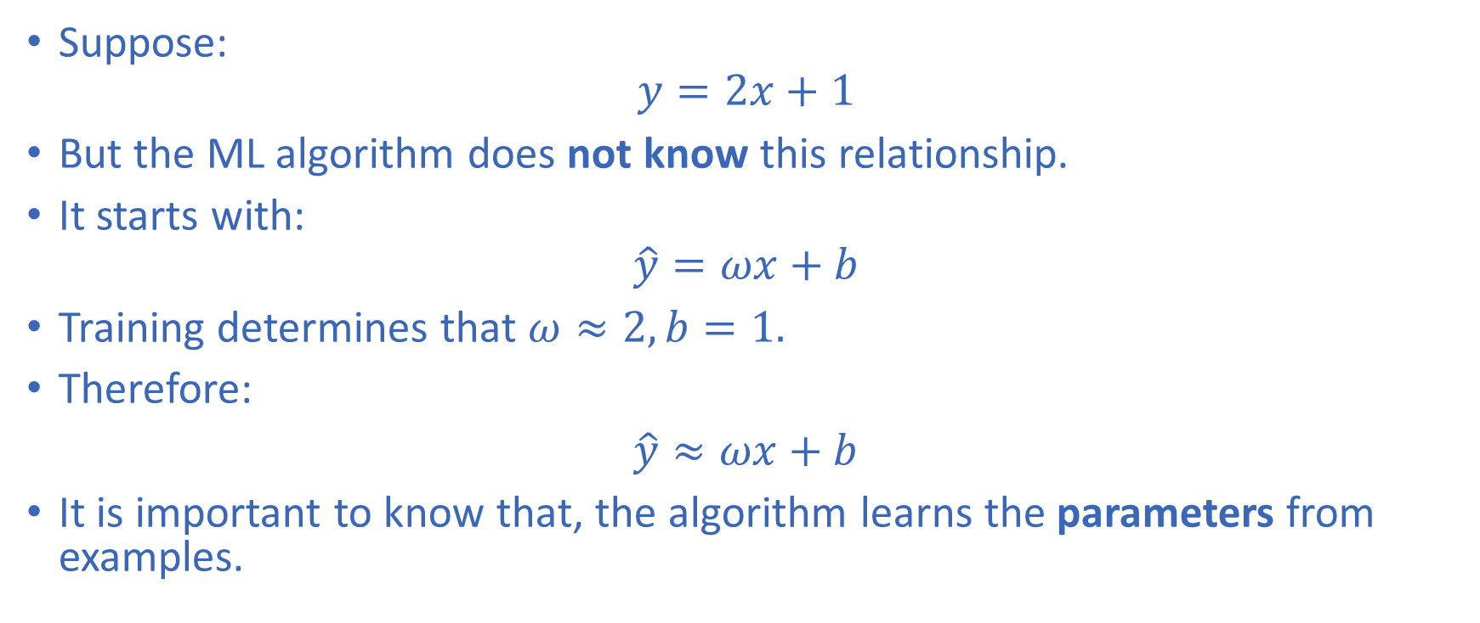
Example: Learning a Straight Line

Slide 39
Train-Test Split
Suppose we have 1,000 observations.
We train a model using all 1,000 observations.
Then we test it on the same 1,000 observations.
The model gets:
98% accuracy!
Is it a good model?
Not necessarily.
Because the model has already seen the data.

Slide 40
Training Data vs Test Data
We divide the dataset into separate parts.
Training Set
  Used to:
  Learn model parameters
  Fit the model
  Minimize training loss
Test Set
  Used to:
  Evaluate the final model
  Estimate performance on unseen data
Fundamental principle
Never use test data to train the model.

Slide 41
Typical Train-Test Split
A common choice:
  80% Training AND 20% Testing
  D_{train}​ = 80% AND D_{test}​ = 20%
Example:
  10,000 samples
  8,000 training
  2,000 testing
Other common choices:
  70/30
  75/25
  80/20
  90/10
There is no universal best ratio.

Slide 42
Train / Validation / Test
For more reliable ML development, we often use three datasets:
Training Set
  Used to learn parameters.
Validation Set
  Used to:
  Select hyperparameters
  Compare models
  Tune architecture
Test Set
  Used only for final evaluation.
For example, we may use 70% data for training, 15% for validation, and 15% for testing

Slide 43
Parameters vs Hyperparameters
Parameters
Learned automatically from training data.
Examples:
  Neural network weights
  Linear regression coefficients
  Decision tree split parameters
Validation data helps us choose hyperparameters.
Hyperparameters
Set before/during model development.
Examples:
  Learning rate
  Number of hidden layers
  Number of neighbors k
  Tree depth
  Batch size

Slide 44
A Common Mistake
Wrong approach
  Training data:
  Train + Test → Model
  Then:
  Same Test Data → Model selection
  ❌ This causes data leakage.
Correct approach
  Training → Learn parameters
  Validation → Tune model
  Test → Final evaluation

Slide 45
Generalization
The most important goal of machine learning is not memorization.
It is performing well on new, unseen data.
A model should learn the underlying pattern rather than simply memorize the training examples.
Example
  Train on January–October electricity data
  Test on November–December electricity data
  If the model performs well on November–December, then it has good generalization.

Slide 46
Training vs Generalization
Imagine students preparing for an exam.
Student A
  Memorizes the exact questions from practice sheets and gets
  95% on practice questions and 55% on new questions
Student B
  Understands the underlying concepts and gets:
  90% on practice and 88% on new questions
Which student learned better?
Student B.
This is analogous to generalization in ML.

Slide 47
Overfitting
The model learns the training data too closely.
It may learn:
  Noise
  Outliers
  Random patterns
Typical behavior
  Training performance → Excellent
  Test performance → Poor
If the training accuracy is 99% and testing performance is 72%, the model is likely overfitted.

Slide 48
Underfitting
The model is too simple to capture the underlying relationship.
Typical behavior:
  Training performance → Poor
  Testing performance → Poor
If the training accuracy is 65% and the testing accuracy is 62%, the model is likely underfitted.

Slide 49
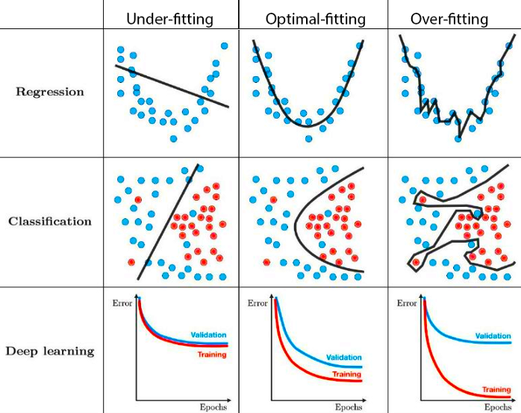
Overfitting vs Underfitting
Model | Training | Testing | Interpretation
Too simple | Poor | Poor | Underfitting
Appropriate | Good | Good | Good generalization
Too complex | Excellent | Poor | Overfitting

Slide 50
Generalization Gap
Generalization Gap = |Training Error − Test Error|
A large difference between training and test performance can indicate overfitting.
Example
  Training error = 2%
  Test error = 20%
  Generalization gap = |2 – 20| = 18%
  Large gap → possible overfitting.

Slide 51
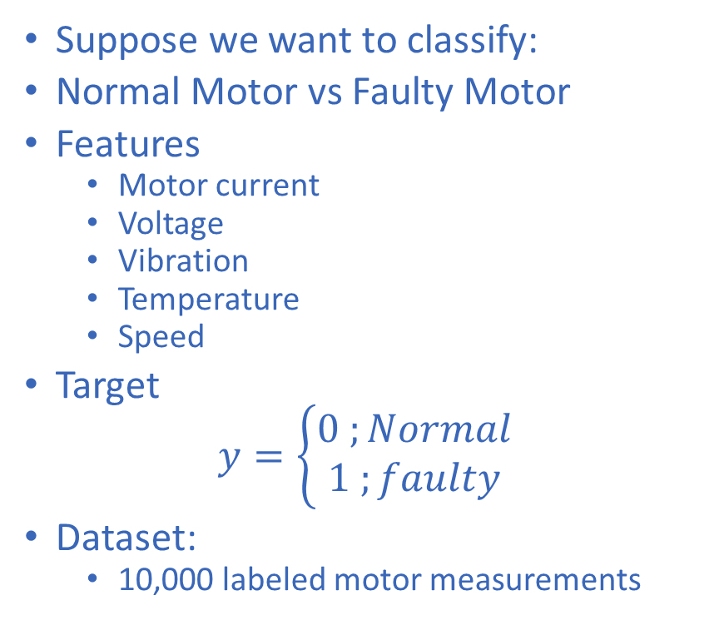
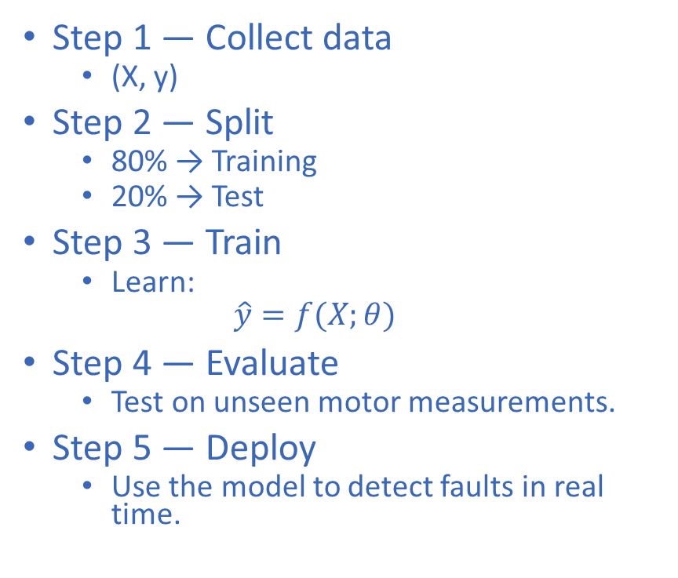
Case Study: Motor Fault Detection

Slide 52
Case Study: Motor Fault Detection
What If We Get This Result?
Model A
  Training accuracy = 99%
  Testing accuracy = 72%
Model B
  Training accuracy = 94%
  Testing accuracy = 91%
Which model should we choose?
Model B
Because its performance generalizes better to unseen data.

Slide 53
Important Practical Issues
Random Splitting Is Not Always Appropriate
For ordinary independent data:
  A random train-test split may be appropriate.
But consider electricity load forecasting
  Data:
  Jan → Feb → Mar → ... → Dec
  If we randomly mix all observations:
  ❌ Future information may indirectly enter training.
Better approach:
  Past → Training
  Later period → Validation/Test

Slide 54
Data Leakage
Information from outside the training data improperly influences model training.
Examples:
  Using test data during training
  Scaling before splitting
  Using future information
  Selecting features using the entire dataset
  Duplicated samples across train and test
Result
  The model appears better than it really is.
Leakage can produce misleadingly high performance.

Slide 55
The Golden Rule
Before evaluating a model, ask:
Has the model seen this information before?
If YES:
❌ It is not a proper test.
If NO:
✅ It is useful for evaluating generalization.

Slide 56
Main Challenges of Machine Learning
Insufficient Quantity of Training Data
Nonrepresentative Training Data
Poor-Quality Data
Irrelevant Features
Imbalanced Datasets
Overfitting
Underfitting

